Slide 1
SOEN 387
WEB-BASED ENTERPRISE
APPLICATIONS DESIGN
TUTORIAL – 5
Using Databases
By
Vasu Ratanpara

Slide 2
What
is JDBC?
1

Slide 3
JDBC
JDBC stands for java database connectivity, which is a standard java API for database independent connectivity between the java programming language and a wide range of databases.
JDBC provides Java programs to contain database-independent code.
The JDBC library includes APIs for each of the tasks mentioned below that are commonly associated with database usage.
Making a connection to a database.
Creating SQL or MySQL statements.
Executing SQL or MySQL queries in the database.
Viewing & modifying the resulting records.

Slide 4
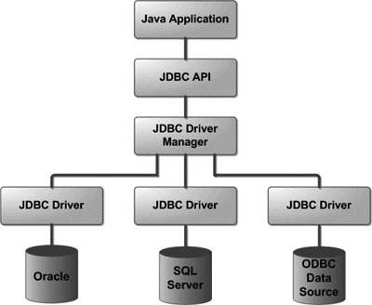
JDBC Architecture

Slide 5
JDBC : Common Components
DriverManager
Driver
Connection
Statement
ResultSet
SQLException

Slide 6
Enough Talking
Let’s start coding

Slide 7
Create Database
Let’s create Database of our university in MySQL, which can store student’s details.
To create Database and use it follow given syntax:
Syntax: CREATE DATABASE DATABASE_NAME;
SQL> CREATE DATABASE Concordia;
Syntax: USE DATABASE_NAME;
SQL> USE Concordia;
Create a Table name user_details in Concordia database;
Syntax: CREATE TABLE table_name ( `column1` DATATYPE , `columnt2` DATATYPE, … ) ;
SQL> CREATE TABLE `user_details` ( `user_id` int(11) NOT NULL, `username` varchar(255) DEFAULT NULL, `first_name` varchar(50) DEFAULT NULL, `last_name` varchar(50) DEFAULT NULL, `gender` varchar(10) DEFAULT NULL, `password` varchar(50) DEFAULT NULL, `status` tinyint(10) DEFAULT NULL );

Slide 8
Insert data in Database
Create a Table name user_details in Concordia database;
Syntax: INSERT INTO table_name VALUES (column1, column2, ...);
SQL> INSERT INTO `user_details` (`user_id`, `username`, `first_name`, `last_name`, `gender`, `password`, `status`) VALUES (1, 'rogers63', 'david', 'john', 'Female', 'e6a33eee180b07e563d74fee8c2c66b8', 1);
NOTE: Add more data in your database from here

Slide 9
JDBC: Basic steps to use a database in Java
Establish a connection
Create JDBC Statements
Execute SQL Statements
GET ResultSet (IF any)
Close connections

Slide 10
Step1: Establish a connection
// JDBC driver name and database URL
String JDBC_DRIVER = "com.mysql.cj.jdbc.Driver";
String DB_URL = "jdbc:mysql://localhost:3306/";
String DB_NAME = “concordia";
// Database credentials
String DB_USER = "root";
String DB_PASSWORD = "";
NOTE:
1. If you are using any other database like PostgreSQL etc. you have to change your JDBC driver as well as DB
URL accordingly. Also, All the above code is in Main() method.
2. Here use your own DB username and DB password
3. Class com.mysql.jdbc.Driver This is deprecated. The new driver class is com.mysql.cj.jdbc.Driver.
(It will work with old class but with warning )

Slide 11
Step1: Establish a connection (Cont.)
….
try
{
// Register JDBC driver
Class.forName(JDBC_DRIVER);
//Open a connection
System.out.println("Connecting to database...");
Connection conn = DriverManager.getConnection(DB_URL+DB_NAME,DB_USER,DB_PASSWORD);
….
}

Slide 12
Step2: Create JDBC Statements
try
{
….
//Create JDBC Statements
System.out.println("Creating statement...");
stmt = conn.createStatement();
….
}

Slide 13
Step3: Execute SQL Statements
try
{
….
//Execute a query
String sql = "SELECT user_id, first_name, last_name FROM user_details";
ResultSet rs = stmt.executeQuery(sql); // We may not have ResultSet for other queries
….
}

Slide 14
Step4: GET ResultSet (If Applicable)
try
{
….
// Extract data from result set
while(rs.next())
{ //Retrieve by column name
int id = rs.getInt(“user_id");
String firstName = rs.getString("first_name");
String lastName = rs.getString("last_name");
// User your data here (i.e print or store in Arraylist)
}
….
}

Slide 15
Step5: Close connections
try
{
//Close connections to clean-up environment
rs.close();
stmt.close();
conn.close();
}
catch(Exception e){
// handle your exceptions here
// Add more catch statements (i.e. for SQLException)
}

Slide 16
Now Consider a situation when you need to run more than 100+ SQL queries. Imagine yourself writing the above steps again and again.
To avoid this we will create a new class which will handle the work of DB Connection and we will use a static method (think why!) which will return a DB Connection Object and later on we can reuse it as many time as we want.
(We will call that file as DBConnection.java)
DRY Rule
Don’t repeat yourself
Reduce redundant code
Less LOC (Line of Code)

Slide 17
DBConnection.Java
import java.sql.*;
public class DBConnection {
// NOTE: It'd be better to get them from a properties or XML configuration file
// JDBC driver name and database URL
static final String JDBC_DRIVER = "com.mysql.jdbc.Driver";
static final String DB_URL = "jdbc:mysql://localhost:3306/";
static final String DB_NAME = "concordia";
// Database credentials
static final String DB_USER = "root";
static final String DB_PASSWORD = "";
static Connection conn = null;
…..

Slide 18
DBConnection.Java (Cont.)
…..
public static Connection getConnection() {
try{
//Register JDBC driver
Class.forName(JDBC_DRIVER);
//Open a connection
//System.out.println("Connecting to database...");
conn = DriverManager.getConnection(DB_URL+DB_NAME,DB_USER,DB_PASSWORD);
return conn;
} catch (SQLException e){
throw new RuntimeException("Error connecting to database",e);
} catch (ClassNotFoundException e){
throw new RuntimeException("Error Class Not Found",e);
}
}
…..

Slide 19
DBConnection.Java (Cont.)
…..
public static void closeConnection() throws SQLException{
//Close connection
if(conn!=null) conn.close();
}
}

Slide 20
Insert Record using JDBC
try
{
….
// insert execute query
String sql = “INSERT INTO user_details ” + “VALUES( 100 , ‘Zara’ , ‘Ali’ , 18)”;
stmt.executeUpdate(sql);
String sql = “INSERT INTO Registration ” + “VALUES( 101 , ‘Mahnaz’ , ‘Fatma’ , 25)”;
stmt.executeUpdate(sql);
String sql = “INSERT INTO Registration ” + “VALUES( 102 , ‘Zaid’ , ‘Khan’ , 30)”;
stmt.executeUpdate(sql);
….
}

Slide 21
Select Record using JDBC
try {
….
// select execute query
String sql = “SELECT id, first , last , age FROM Registration”;
ResultSet rs = stmt.executeQuery(sql);
// Extract data from result set
while(rs.next()) {
//Retrieve by column name
int id = rs.getInt(“id”);
int age = rs.getInt(“age”);
String first = rs.getString(“first”);
String last = rs.getString(“last”);

Slide 22
Select Record using JDBC(cont.)
//Display values
System.out.println( “ID: ” + id );
System.out.println( “, Age: ” + age );
System.out.println( “, First: ” + first );
System.out.println( “, Last: ” + last );
}
rs.close();
….
}

Slide 23
Update Record using JDBC
try {
….
// Update execute query
String sql = “UPDATE Registration” + “SET age = 30 WHERE id in (100,101)”;
stmt.executeUpdate(sql);
// Now you can extract all the records to see updated records
String sql = “SELECT id, first , last , age FROM Registration”;
ResultSet rs = stmt.executeQuery(sql);
while(rs.next()) {
//Retrieve by column name
int id = rs.getInt(“id”);
int age = rs.getInt(“age”);
String first = rs.getString(“first”);
String last = rs.getString(“last”);

Slide 24
Update Record using JDBC (cont.)
//Display values
System.out.println( “ID: ” + id );
System.out.println( “, Age: ” + age );
System.out.println( “, First: ” + first );
System.out.println( “, Last: ” + last );
}
rs.close();
….
}

Slide 25
Delete Record using JDBC
try {
….
// Delete execute query
String sql = “DELETE FROM Registration” + “ WHERE id = 101”;
stmt.executeUpdate(sql);
// Now you can extract all the records to see remaining records
String sql = “SELECT id, first , last , age FROM Registration”;
ResultSet rs = stmt.executeQuery(sql);
while(rs.next()) {
//Retrieve by column name
int id = rs.getInt(“id”);
int age = rs.getInt(“age”);
String first = rs.getString(“first”);
String last = rs.getString(“last”);

Slide 26
Delete Record using JDBC (cont.)
//Display values
System.out.println( “ID: ” + id );
System.out.println( “, Age: ” + age );
System.out.println( “, First: ” + first );
System.out.println( “, Last: ” + last );
}
rs.close();
….
}

Slide 27
DAO Pattern
The Data Access Object (DAO) pattern is a structural pattern that allows us to isolate the application/business layer from the persistence layer (usually a relational database, but it could be any other persistence mechanism) using an abstract API.
The functionality of this API is to hide from the application all the complexities involved in performing CRUD operations in the underlying storage mechanism. This permits both layers to evolve separately without knowing anything about each other.

Slide 28
“
Let’s see an Example of DAO pattern

Slide 29
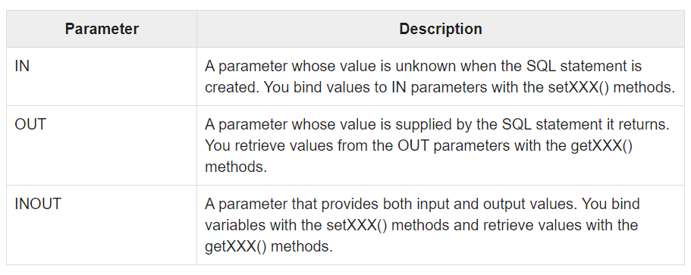
Using Parameters
There are three types of parameters which exist :
Which are IN, OUT, and INOUT.
The PreparedStatement object only uses the IN parameter.
The CallableStatement object can use all the three.

Slide 30
Creating a procedure
DELIMITER $$
DROP PROCEDURE IF EXISTS ‘EMP’ . ‘getEmpName’ $$
CREATE PROCEDURE ‘EMP’ .’getEmpName’ ( IN EMP_ID INT , OUT EMP_FIRST VARCHAR(255))
BEGIN
SELECT first INTO EMP_FIRST
FROM Employees
where ID= EMP_ID;
END $$
DELIMETER;

Slide 31
Big Title
The marketing mix is a business tool used in marketing and by marketers, originally can be used

Slide 32
CONTENT IN TWO COLUMNS
Content A
Content B
Content itself is what the end-user derives value from also can refer to the information provided through the medium, the way in which the information was presented, as well as the added features included in the medium in which that information was delivered. The medium, however, provides little to no value to the end-user without the information and experiences that make
Content itself is what the end-user derives value from also can refer to the information provided through the medium, the way in which the information was presented, as well as the added features included in the medium in which that information was delivered. The medium, however, provides little to no value to the end-user without the information and experiences that make

Slide 33
YOUR
HEADLINE
1
Build better presentations in less time

Slide 34

Hello!
I Am John Miller
I am here because I love to design
presentations.
You can contact me at @username

Slide 35
CONTENT IN TWO COLUMNS
Content A
Content B
Content C
Content itself is what the end-user derives value from also can refer to the information provided through the medium, the way in which the information was presented, as well as the added features included in the medium in which that information was delivered.
Content itself is what the end-user derives value from also can refer to the information provided through the medium, the way in which the information was presented, as well as the added features included in the medium in which that information was delivered.
Content itself is what the end-user derives value from also can refer to the information provided through the medium, the way in which the information was presented, as well as the added features included in the medium in which that information was delivered.

Slide 36

A Picture Is Worth A Thousand Words
Itself is what the end-user derives value from also can refer is what the end-user derives value from also can refer to the information provided through the medium.

Slide 37

Use Big Images
To Show Ideas

Slide 38
USE SHAPE TO EXPLAIN IDEAS
TITLE 01
TITLE 02
TITLE 03

Slide 39
TABLES TO COMPARE DATA
 | A | B | C
Content A | 100 | 200 | 400
Content B | $67,000 | $56,000 | $78,000
Content C | 4500 | 60000 | $8,000
Content D | 34000 | $400 | $600
Content E | $90 | $800 | $1,000

Slide 40
WORLD MAP
Headquarters

Slide 41
56,790,500
Write here your big numbers

Slide 42
FUNNY FACTS
56,790,500
130%
56,790,500
Revenue from sales
Project Achievements
Users around the world

Slide 43
OUR PROCESS
The marketing mix is a business tool used in marketing
The marketing mix is a business tool used in marketing
The marketing mix is a business tool used in marketing
The marketing mix is a business tool used in marketing

Slide 44
SOME FEATURES
Content A
Content B
Content B
Itself is what the end-user derives value from also can refer to the information
Itself is what the end-user derives value from also can refer to the information
Itself is what the end-user derives value from also can refer to the information
Content C
Content D
Content D
Itself is what the end-user derives value from also can refer to the information
Itself is what the end-user derives value from also can refer to the information
Itself is what the end-user derives value from also can refer to the information

Slide 45
CHARTS TO PRESENT DATA
86%
59%
50%
37%
Q1
Q2
Q3
Q4

Slide 46


iPhone App
Project
Itself is what the end-user derives value from also can refer to the information

Slide 47

Laptop
Project
Itself is what the end-user derives value from also can refer to the information

Slide 48

Content B
Itself is what the end-user derives value from also can refer to the information
Content D
Itself is what the end-user derives value from also can refer to the information

Slide 49
Thanks!
Any questions?
You can find me at: @username email@domain.com

Slide 50
CREDITS
Special thanks to all people who made and share these awesome resources for free:
Presentation template designed by Slidesmash
Photographs by unsplash.com and pexels.com
Vector Icons by Matthew Skiles

Slide 51
Presentation Design
This presentation uses the following typographies and colors:
Free Fonts used:
https://www.fontsquirrel.com/fonts/nunito
Colors used

